Slide 1
SMART GLASS FOR VISUALLY IMPAIRED PEOPLE
TEAM
KARPAGAM
SUKI S
NANDHEES P
MVP – Pitch – slide set

Slide 2

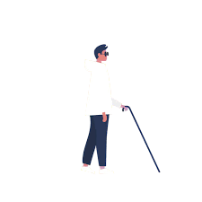
The PROBLEMS
FACEING BLIND PEOPLES
The blind people needs of society to give them more care and attention
Safe walking blind life is the biggest problem
The blind people faceing many problems to
Reach t destination
They didn’t know hanging in front of
obstacles

Slide 3
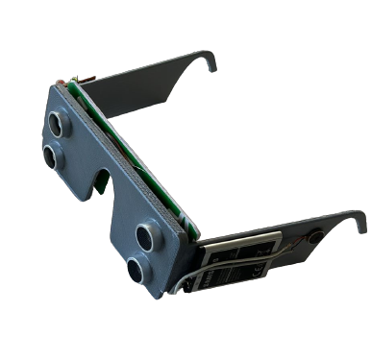
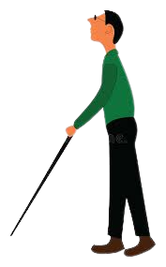
Solution
This device helps the blind people to easily feel the obstacles in front of them and can save them from accidents
The concept of obstacle detection by Two SONAR sensor has been used here
If eny obstacle comes in two meter front of blind people it will alart vibrater motor
It has a fall detection also the blind person accidently felled down to the ground the tilte sensor will triggered and Make call to his guardien automatically.
Sonar glass

Slide 4
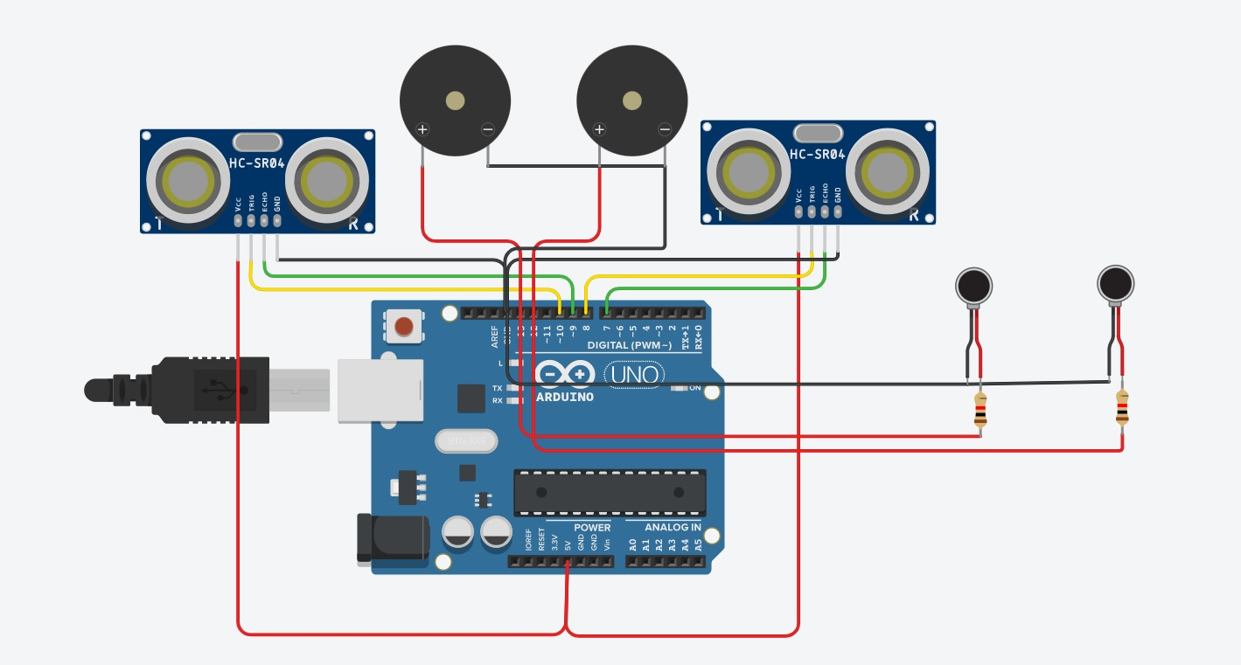

CIRCUIT DIAGRAM

Slide 5


TEAM KARPAGAM
NANDHEESH P
SUKI S

Slide 6
Thank
You

